Slide 2


DevOps in Open and Inner sourcing world
Divya Vaishnavi | Principal Program Manager | Azure DevOps
@divyavaishnavi
/in/divyavaishnavi

Slide 3








Every company is becoming a software company
62% of CEOs have an initiative to make their businesses more digital
Hiring of software engineers growing at 11% more in non-tech

Slide 4
DevOps
People. Process. Products.
Build& Test
Deploy
DevOps is the union of people, process, and products to enable continuous delivery of value to your end users.
“
Continuous Delivery
Develop
Operate
”
Plan & Track
Monitor & Learn

Slide 5















Azure has a comprehensive DevOps foundation
Add a drill down detail slides for each piece in appendix
Azure Boards
Azure Repos
Azure Pipelines
Azure Kubernetes Service
Azure Monitor
Azure Test Plans
Azure DevTest Labs
Azure Security Center
Azure Artifacts
Visual Studio App Center
Azure Front Door
Azure Policy
Azure Cost Manager
Azure Key Vault
Azure DDoS Protection

Slide 6

One Engineering System using Azure
There cannot be a more important thing for an engineer, for a product team, than to work on the systems that drive our productivity.
So I would, any day of the week, trade off features for our own productivity.
I want our best engineers to work on our engineering systems, so that we can later on come back and build all of the new concepts we want.
- Satya Nadella

Slide 7

107,000 Engineers in Microsoft working with Azure DevOps
One second per day is like adding
One minute per day is like adding
One hour per day is like adding
3.7
163
$2.7B
More people to Microsoft
More people to Microsoft
per year

Slide 8
DevOps at Microsoft
Azure DevOps is the toolchain of choice for Microsoft engineering with over 107,000 internal users
➔
https://aka.ms/DevOpsAtMicrosoft
442k
Pull Requests per month
155
Petabytes of build artifacts managed
28k
Work items created per day
82,000
Deployments per day
2.4m
Private Git commits per month
3.5k Open Source repos
12k
Employees contributing to open source
Data: Internal Microsoft engineering system activity, June 2019

Slide 9

Microsoft Open Source

Slide 10
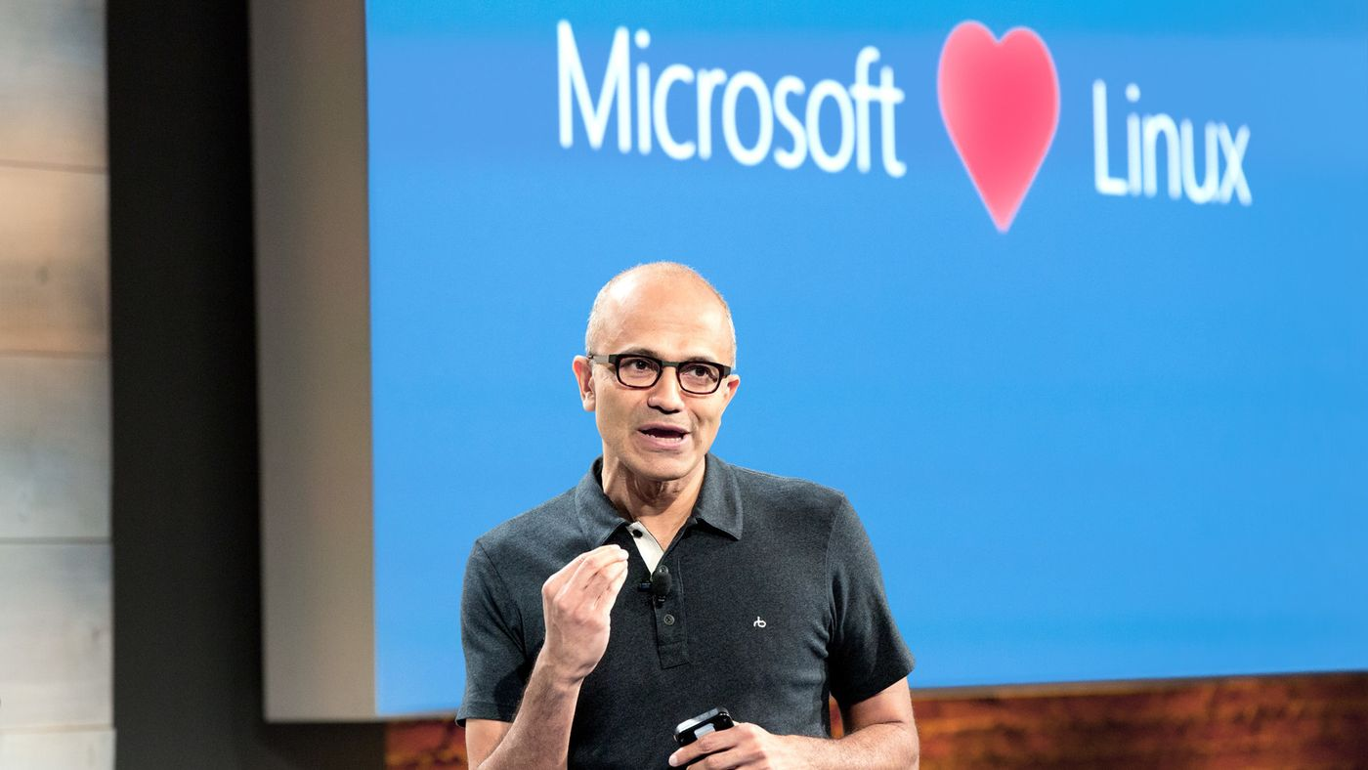
Microsoft Open Source
2018
Visual Studio Code ranked #1 developer tool
Azure Service Fabric Open Sourced
Azure Sphere with Linux kernel
Intent to acquire GitHub announced
~5,000 Microsoft employees committing to open source projects on GitHub
Azure trending to 50% Linux
Microsoft continues as largest contributor to open source projects on GitHub
“Judge us by the actions we have taken in the recent past, our actions today and in the future”
—Satya Nadella, CEO Microsoft
2017
Microsoft Azure Kubernetes Service launched
Draft, Brigade, Kashti projects submitted to Kubernetes community
Microsoft joins Cloud Native Computing & Cloud Foundry Foundations
SQL 2017 on Linux
Windows source code moved to Git
Azure Databricks (Apache Spark) announced
2016
.NET Core 1.0
PowerShell Core
Windows Subsystem for Linux in Windows 10
Microsoft joins Linux Foundation
GitHub recognizes Microsoft as a top open source contributor
2015
Visual Studio Code released
HDInsight (Hadoop/ Ubuntu) announced
Microsoft jointly forms Node.js foundation
2014
Satya “Microsoft loves Linux”
Microsoft org on GitHub created
.NET Foundation created
2012
TypeScript released
Git support added to TFS and Visual Studio
2012
2014
2015
2016
2017
2018

Slide 11
Inner sourcing
Helps teams promote transparency, re-use and enable innovation. It also promotes higher quality code

Slide 12

Be INVITING!!

Slide 13

Reduce Friction

Slide 14

Be Open and Responsive
Measure TTFR

Slide 15

Be a considerate contributor

Slide 16

Team Performance

Slide 17
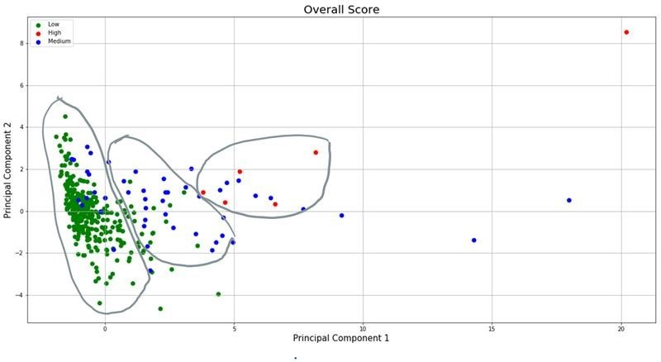
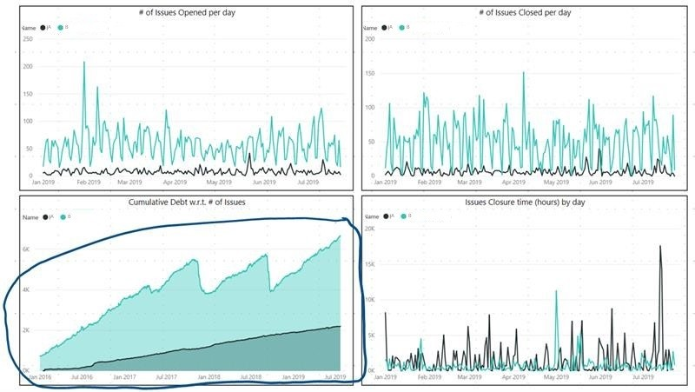
Behaviors decide Team Performance
Analyzed
371 code repositories and
12 Parameters

Slide 18

Demo

Slide 19


Thank you!!!
Divya Vaishnavi
@Divya Vaishnavi
linkedin.com/in/divyavaishnavi

